Slide 1
Self Service Publishing Project
Patrick Desbrow
Improve Tollgate Review

Slide 2
BPM Project Summary
Problem Statement
As of some date December 2010, the [J. D. Power] Client System Group (CSG) spends approximately 22 hours or $2,000 to publish a single study on the existing Business Center web deliverable.
Currently, there are too many individual steps in a single study. The existing process is manual and requires unnecessary IT staff to ensure accuracy.
In addition, the number of reported errors in the publishing process indicate potential issues with quality.
Defect Definition/Project Metric
D1: Labor Hours > $1,000
D2: # of Errors > 1
Objective
The aim of this project is to
Decrease this by 50% or 11 hours of labor for a syndicated research study by December 2011.
Reduce the number of reported errors on a study to less than or equal to one.
Leverage standardization and automation.
Standardization allows us to do the same thing the same way which also allows for the automation of common tasks.
This will lower cost and allow for more research deliverables.
Projected Benefits
Based on a current project chargeback rate of $90 per hour, it is estimated that this project would remove $1,000 from a study.
With over 250 Syndicated studies published on the Business Center in 2010, there is the potential for an estimated $250,000 savings each year.
The reduction of reported errors on each study will increase the overall quality of the study.

Slide 3
Improve Key Accomplishments
Collected operational metrics for all syndicated studies published to the business center this year
Revise the detail process steps for the current Business Center publishing process
Identified the major drivers of publishing time and cost
Define the area for improvement and high level solutions for each
Updated the preliminary business case with I&M Finance
The team started with 2 critical questions:
Q1: “Why does the Business Center (BC) publishing process cost so much?”
Q2: “How can the process by improved?”

Slide 4
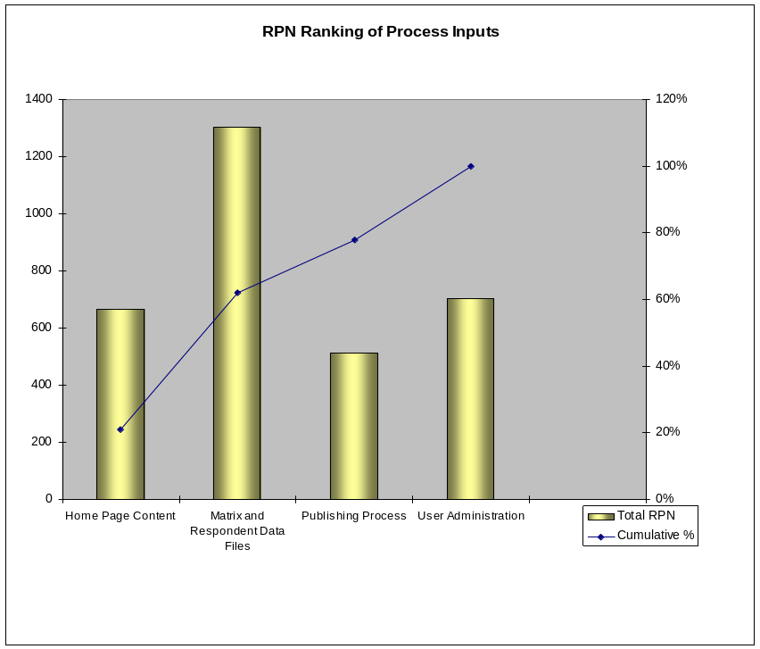
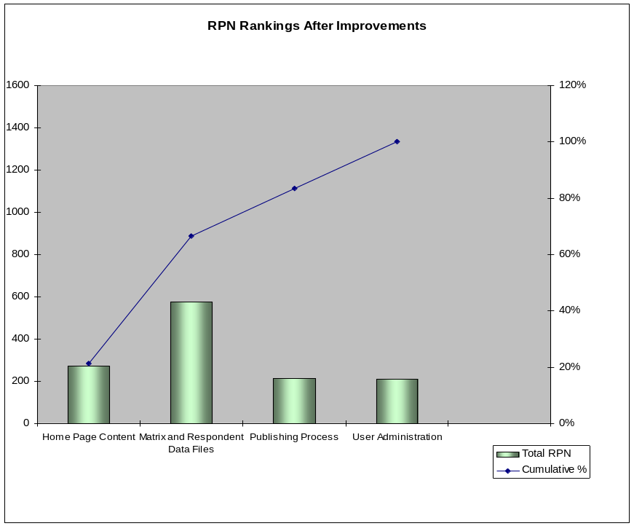
Failure Modes and Effects Analysis (FMEA)
The project team conducted a Failure Modes and Effects Analysis (FMEA) to assess the impact of certain process inputs on a study’s labor hours
  Process inputs that only impact client deliverable production were assessed
  Each process input was analyzed to see what could go wrong; the failures result in additional time/resources/labor
  The assessment assigned a ‘Risk Priority Number’ (RPN) to a process input does not perform as designed or expected (i.e. when a process input fails); the RPN is based on the team’s ratings of:
    Severity – What is the impact to the customer (internal or external)?
    Occurrence – What is the frequency of failure cause?
    Detection – What is the likelihood that the cause would not be detected?

Slide 5
Project Roadmap
2007 vs. 2011
Syndicated Study Average
Then: 277 Hours (per study)
Now: 23 Hours
Future: 11 Hours
Out of Scope
In Scope
Then: 77 Hours
Now: 6 Hours
Future: 3 Hours
Then: 200 Hours
Now: 17 Hours
Future: 8 Hours
Essential Project Management
Hosting
BC QA Testing
Global Enhancements
Client Deliverables
Business-defined pain point
Gather Requirements
Load Data
Create Web Site Presentation
QA Web site
Project Management & Release Study
Then: 40 Hours
Now: 0 Hours
Future: 0 Hours
Then: 40 Hours
Now: 0 Hours
Future: 0 Hours
Then: 80 Hours
Now: 4 Hours
Future: 4 Hours
Then: 25 Hours
Now: 1.5 Hours
Future: .5 Hours
Then: 15 Hours
Now: 11.5 Hours
Future: 3.5 Hours
Next Priority
The focus for this project is the areas that where out of scope in the last BPM project. This includes the Study Release, Quality Assurance and the remaining Project Management tasks in the process.

Slide 6
Current State – Process Map
Planned Project Tasks for Project Management
IT PM sends status to research team
Update
issue log
Review study details on loading environment
Send update(s) to research team
Coordinate publishing tasks
Notify research when task(s) are completed
B
C
B
B
Planned Project Tasks for Study Release
7.0 Hrs (82%) of the time spent in project manager is non value added activities.
Dev team updates study tools based on the issue log
Attend study data publishing meeting
Move data content to production via auto tools
Notify project manager that when task(s) are completed
Load users / assign roles using tool
Notify project manager that when task(s) are completed
A
B
B
1.0 Hrs (67%) of the time spent in Quality Assurance is non value added activities.
Planned Project Tasks for Quality Assurance
1.0 Hrs (33%) of the time spent in study release is non value added activities.
Attend study data publishing meeting
Review study tools on loading environment
Report defects to project manager
Review study tools on production
Review users / assign roles on production
Notify project manager that when task(s) are completed
A
C
B
Forms of Waste
(Non Value Added Activities)
A
There are a number of areas for improvement
The highlighted boxes emphasize the need for a new process and new tools that support automation.
Processing
B
Motion
C
Defects

Slide 7
Future State – Process Map
Planned Project Tasks for Project Management
RT sends email reminder to research team
Update
issue log
RT sends update(s) to research team
Coordinate publishing tasks
RT send update when task(s) are completed
B
Planned Project Tasks for Study Release
7.0 Hrs (82%) of the time spent in project manager has been removed from the process.
Dev team updates study tools based on the issue log
Update
status in RT
Move data content to production via auto tools
Update
status in RT
Load users / assign roles using tool
Update
status in RT
1.0 Hrs (67%) of the time spent in QA has been removed fro the process.
1.0 Hrs (33%) of the time spent in study release has been removed from the process.
Planned Project Tasks for Quality Assurance
View study work queue
in RT
Review study tools on loading environment
Update defects in RT
Review study tools on production
Review users / assign roles on production
Update
status in RT
Forms of Waste
(Non Value Added Activities)
A
There are a number of areas that were improved
The highlighted boxes emphasize the change to a new process
Processing
B
Motion
C
Defects

Slide 8
Improve Findings
Labor hour can be removed
  Goal 1: Project management tasks (7.0 hours, an 82% reduction)
  Goal 2: Study release process (1.0 Hour, a 33% reduction
  Goal 3: Quality assurance steps (1.0 Hour, a 67% reduction)
Other drivers of waste
  Goal 4: Other General / Setup tasks (2.0 Hours, a 33% reduction)
Total Saving Potential: 11.0

Slide 9
Recommendations
R1:
Current: IT managers meet with research teams to discuss the process steps and collect key dates in the publishing schedule.
Recommendation: Replace meetings with a new tab in Research Tool (RT) to collect and store dates.
In addition, a online sit preparation checklist could be added to ensure all of the RT steps are understood.
R2:
Current: Research teams update a global master publishing schedule in MS Excel.
Recommendation: Replace the global master publishing schedule with the same tool in RT (above).
R3:
Current: IT manager sends emails to the research team when key events take place in the publishing process.
Recommendation: RT already sends email alerts. These alerts can be extended to the publishing process as well.
R4:
Current: IT manager maintains offline metrics and reports around the process.
Recommendation: Move the offline metrics and reports into RT and create a management dashboard.
R5:
Current: User permissions are loaded to the Business Center using a combination of manual and automated steps.
Recommendation: Automate the remain steps in the user administration tool and site QA process.

Slide 10
Next Steps
Project Task Owner Target Date
Develop project statement of work Project Management Team Completed
Create a detailed project plan Project Management Team Completed
RT Web site Update – Sprint 1 Technology Team Completed
Web Site Auditing and Validation Research Completed
RT Web site Update – Sprint 2 Technology Team Completed
Web Site Auditing and Validation Research Completed
BPM Control Phase/Handoff BPM Team 06/01/2011

Slide 11
Appendix

Slide 12
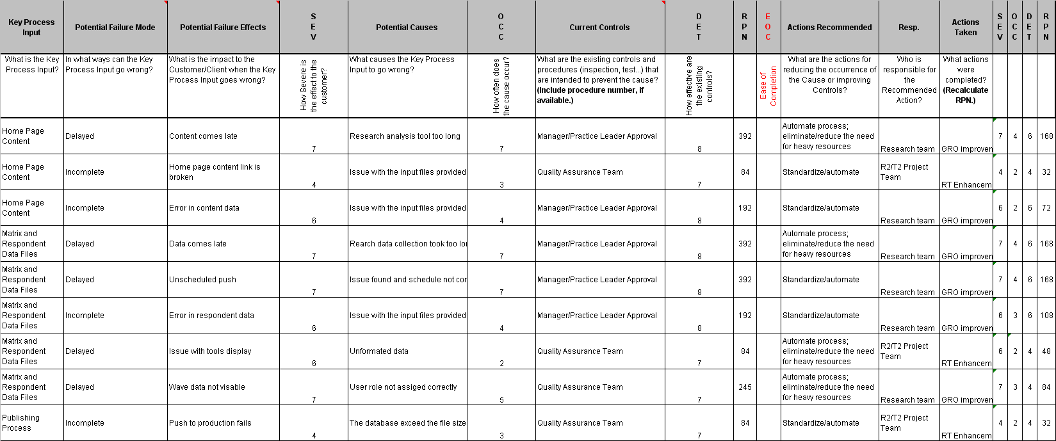
FMEA

Slide 13
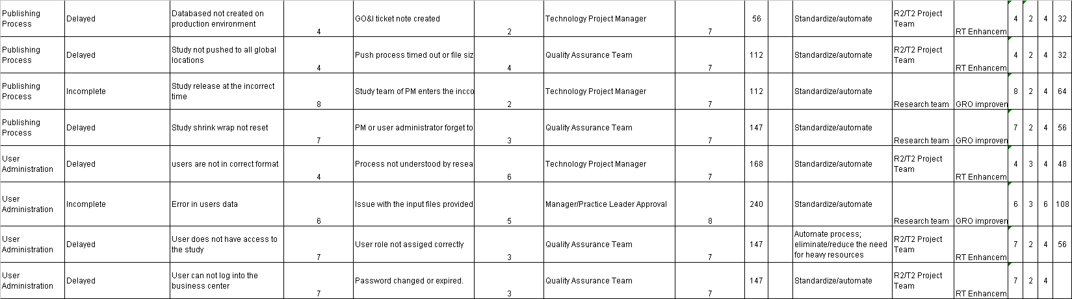
FMEA (continued)

Slide 14
Major Areas for Improvement
Load data to the production environment (Publishing Process)
    Each project can have a high degree of customization
    Programmers currently need to manually move the data and other content between servers ( loading, QA, production environments)
    This process goes through a number of cycles until correct
    This includes the list of users that will have access to the study
Numerous QA Testing Checks Through the Process
    There is a quality assurance test step for each of these manual processes
    The aims is to reduce the amount of testing before a study is delivered
    This includes checking a sample of the users that will have access to the study
Note: There are at least 11 hours of labor saving in these 2 improvement areas
The diagram on the next two pages will highlight the cycle time (C/T) hours

Slide 15
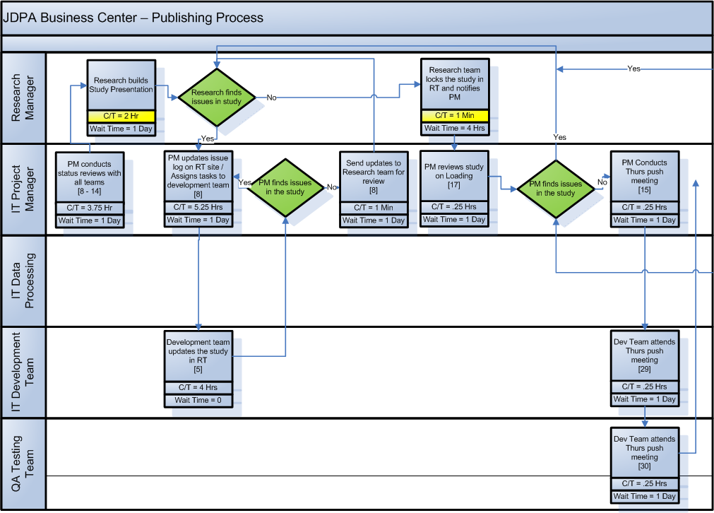
Detail Process Map
1
2
= Opportunities

Slide 16
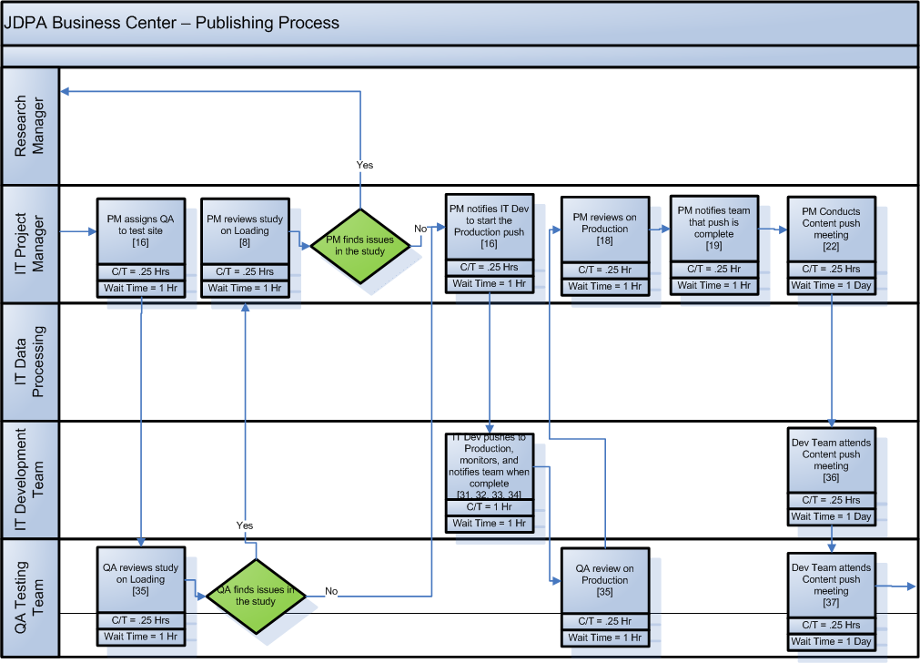
Detail Process Map
1
2
= Opportunities

Slide 17
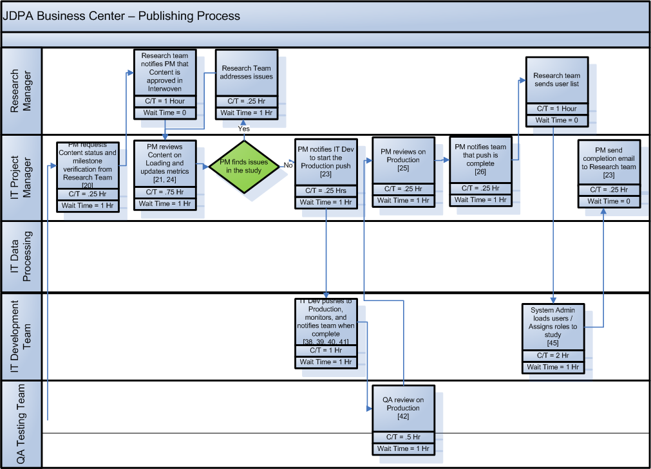
Detail Process Map
2
1
= Opportunities

Slide 18
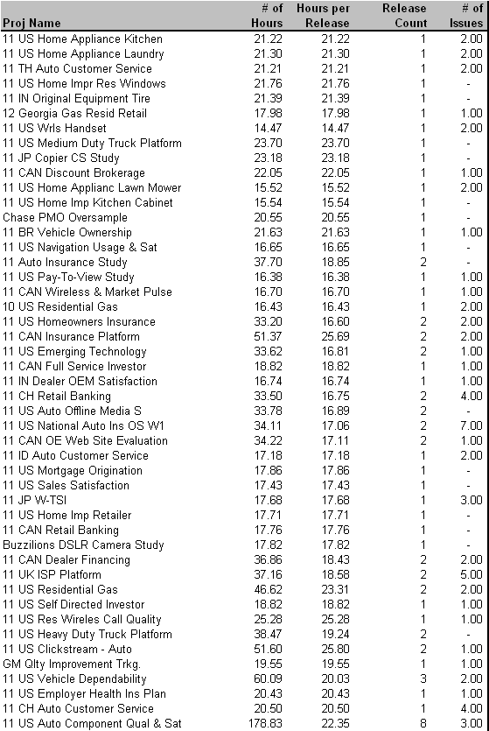
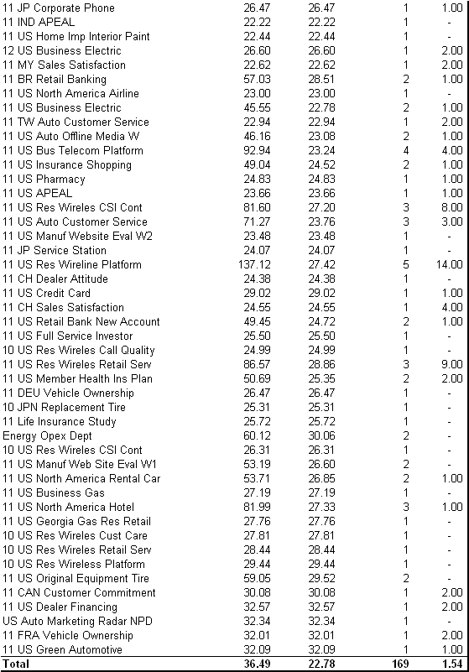
Financial Analysis - Baseline Data
1.
An average of 22.78 hours are spent on activities related to publishing
Source: Full labor hours capture through Timepiece. Contract labor hours captured through ActTime
Notes:
The initial project charter was still rather broad – identifying a need for improvement within the broad spectrum of executing a mail-based study. In that regard, it was important for us to walk through the process and talk to process owners, practice leads, and research project managers to identify the key stakeholders and internal customers. This helped us understand the pain points throughout the process
From the walk-through and interviews, we learned a few things:
1. The existence of a number of handoffs and verification steps that have been institutionalized in our processes
2. An understanding of how scope of work changes and input variation impact our Client Operations (i.e. research production) activities, and
3. The type of data available and necessary for us to gather and analyze in order to prioritize our pain points

Slide 19
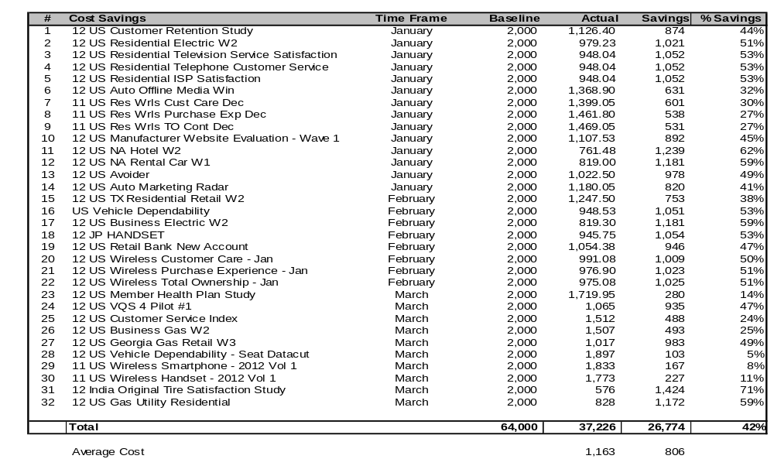
Project Benefits
32 studies where executed in early 2012. As a result, there was a total of $26,774 or 42% saving across these studies. This is an average cost of $1,163 per study.
Source: Full labor hours capture through Timepiece. Contract labor hours captured through ActTime

Slide 20
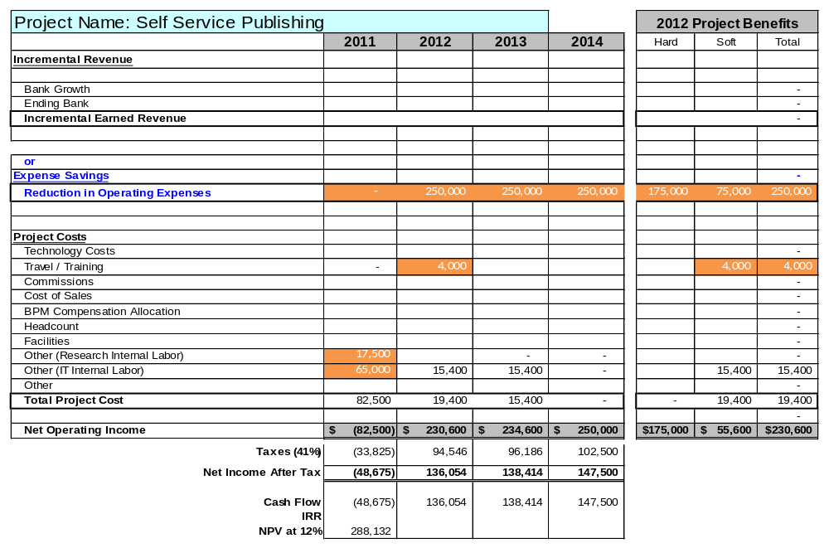
JDPA Business Case Summary

Slide 21
Assumptions
Study Assumptions
190 - Number of studies published each year
250 - Number of publishing event including wave and oversamples
The project is excluding the most complex study that require far more then 22 hours to complete
Labor Improvement Assumptions
Improvement in IT labor hours (50%) associated with the following activities:
  Reducing project management time
  Reduce QA testing tasks
Cost Savings Assumptions
Reduce labor by 11 hours per project, $1,00 cost saving per study
Resource Assumptions
70% of the contract resources will be retired resulting in a hard cost saving of $175,000 in 2013.
All other resources for the soft savings will be moved to other projects outside of syndicated project support
Other Assumptions
Training: $1,000/session x 4 sessions = $4,000
Two senior research managers participate on the team as the internal customer = $17,500
Two IT programmers for 2.5 months will create tools to reduce the cost of the publishing process = $65,000.
No software or hardware costs

